Slide 1

Applied Machine Learning Project Presentation
Hakkıcan BÜLÜÇ-180709061
Adem Varol-200709078
Hüseyin ÇOBAN-180709018

Slide 2

Students’ Data Set Description
In this research, we examined the students of Ortaca Anatolian High School (OAL) and Yunus Emre Anatolian High School (YEAL). The students were asked about their demographic characteristics, the education level of their parents, the number of siblings, the divorce and separation status of the parents, who the student lived with, the living conditions of his parents, and whether there was any illness in his family or himself. No such research has been done for OAL and YEAL schools before. Therefore, this research is a first.

Slide 3
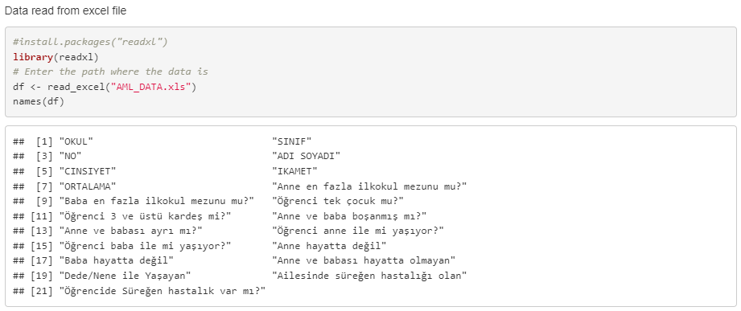
DATA SUMMARY (Attributes)

Slide 4
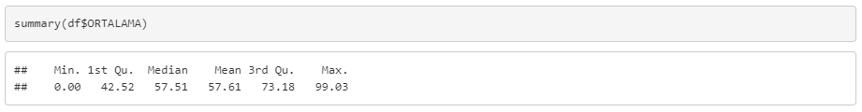
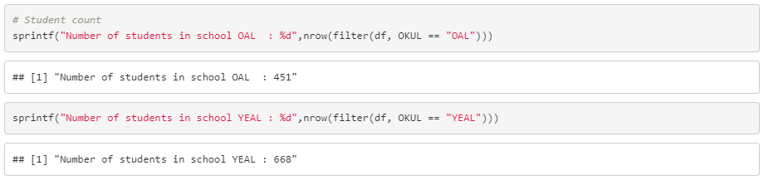
DATA SUMMARY (Statistics-1)

Slide 5
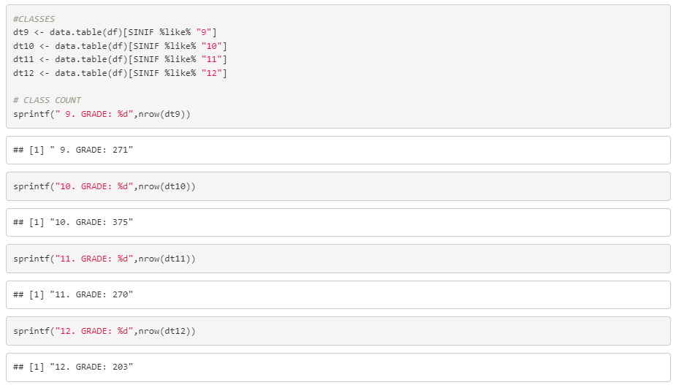
DATA SUMMARY (Statistics-2)

Slide 6
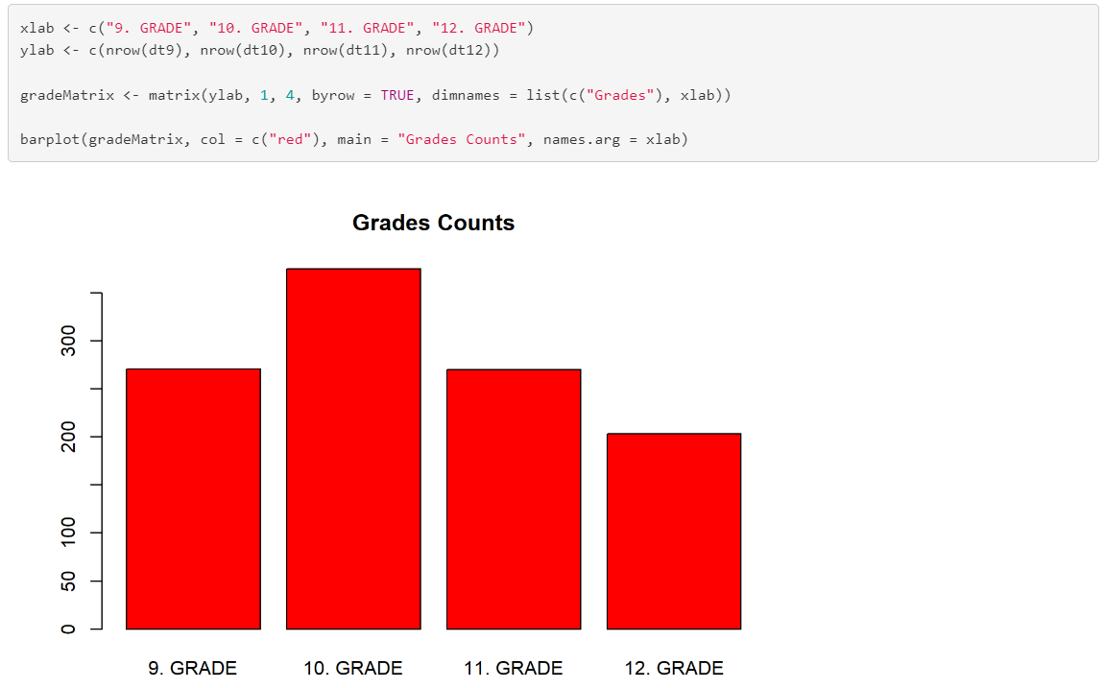
DATA SUMMARY (Statistics-2.1)

Slide 7
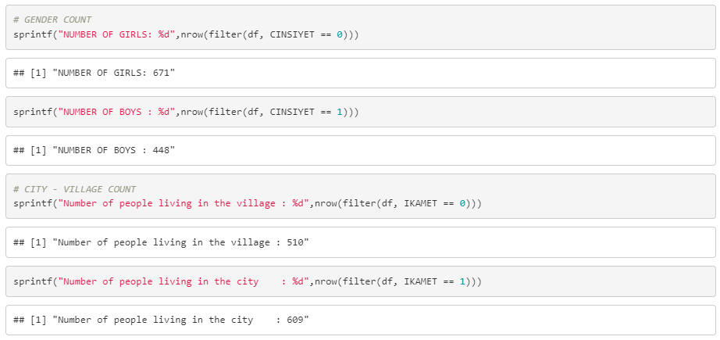
DATA SUMMARY (Statistics-3)

Slide 8
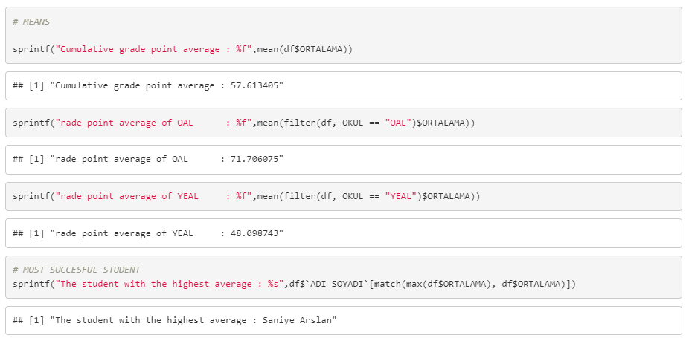
DATA SUMMARY (Statistics-4)

Slide 9

DATA VISUALIZATION

Slide 10
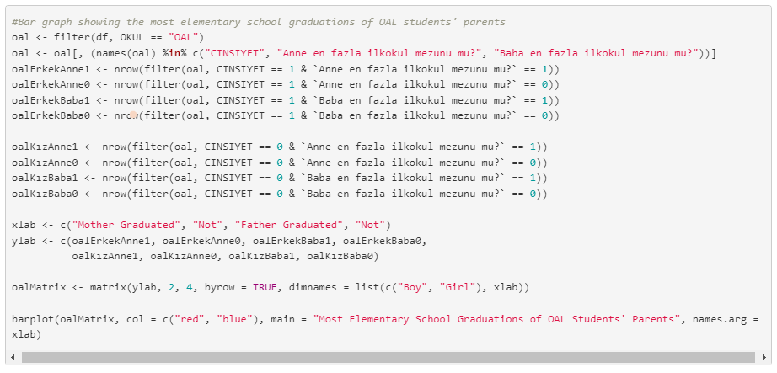
DATA VISUALIZATION – 1

Slide 11
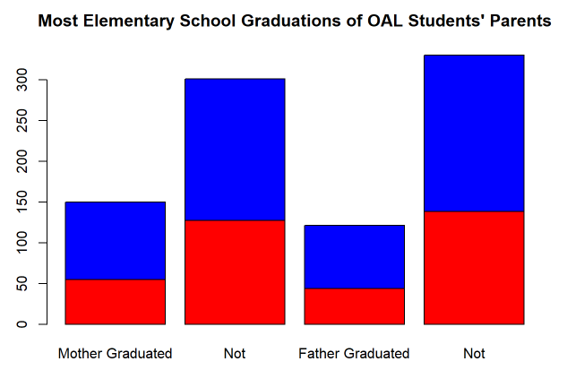
DATA VISUALIZATION – 1.1

Slide 12
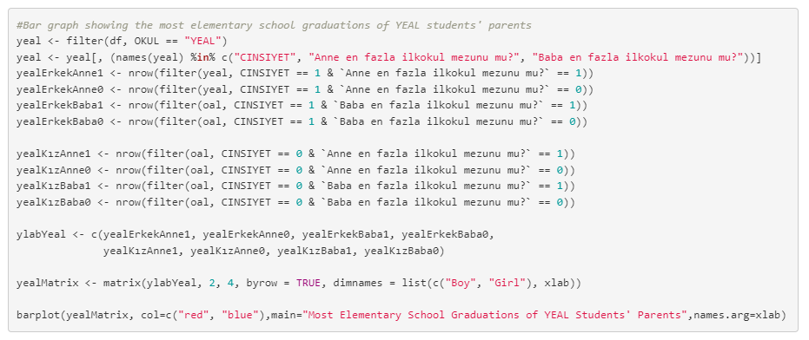
DATA VISUALIZATION – 2

Slide 13
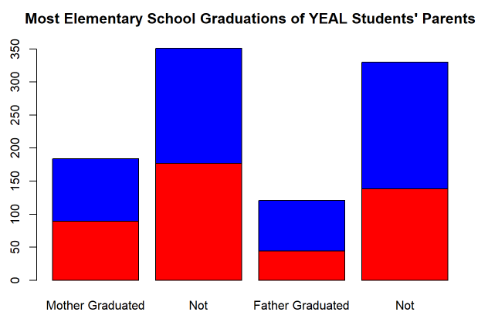
DATA VISUALIZATION – 2.1

Slide 14
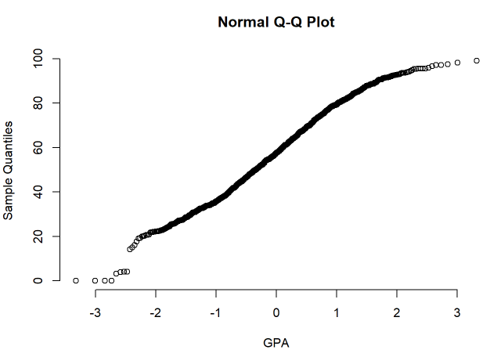
DATA VISUALIZATION – 3

Slide 15
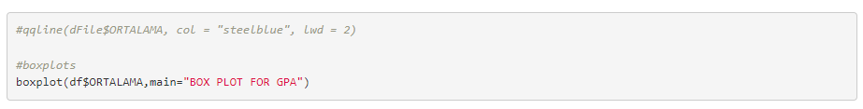
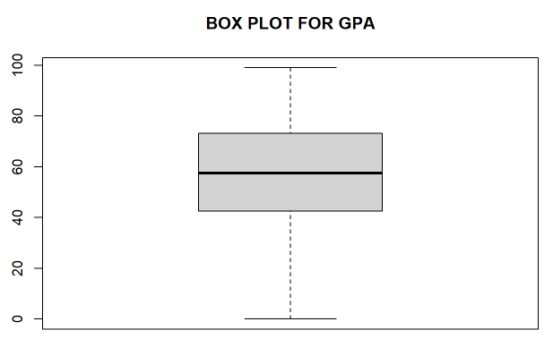
DATA VISUALIZATION – 4

Slide 16

QUESTIONS

Slide 17
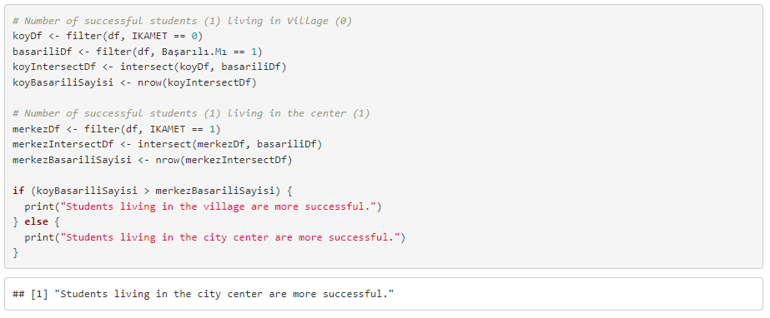
QUESTIONS – 1
1) Are students living in the village more successful than those living in the city center?

Slide 18
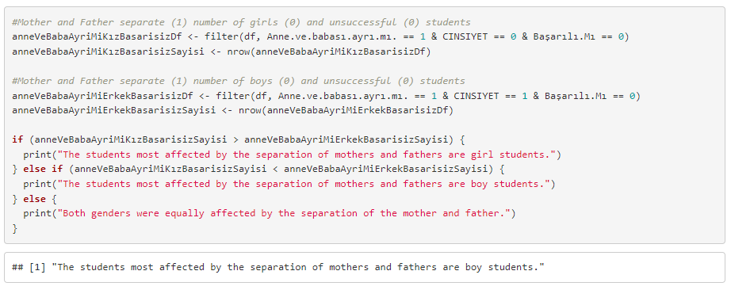
QUESTIONS – 2
2) Are girls or boys most negatively affected by the separation of parents?

Slide 19
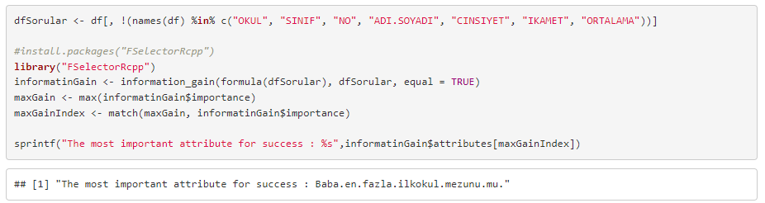
QUESTIONS – 3
3) Which attribute is more important to success?

Slide 20
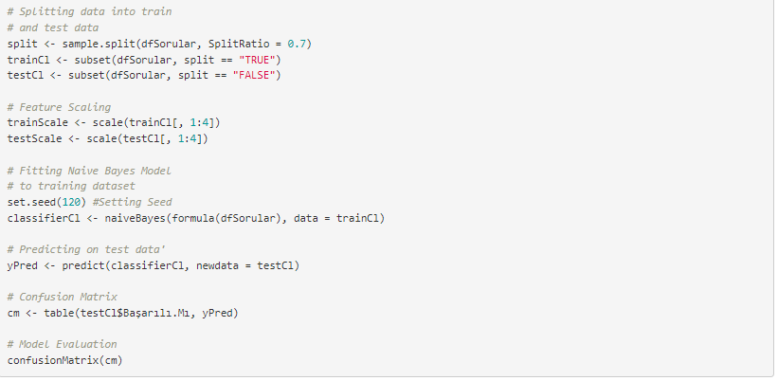
QUESTIONS – 4
4) Can a new student get a passing grade?

Slide 21
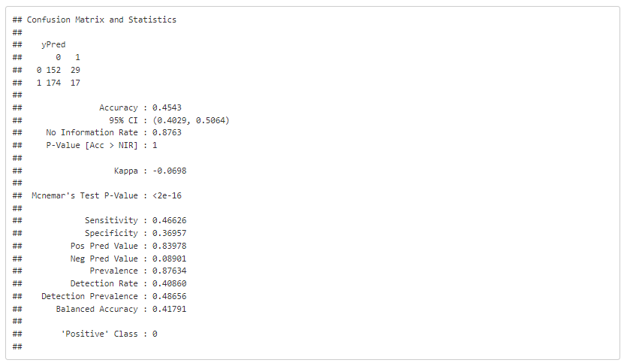
QUESTIONS – 4.1
4) Can a new student get a passing grade?

Slide 22
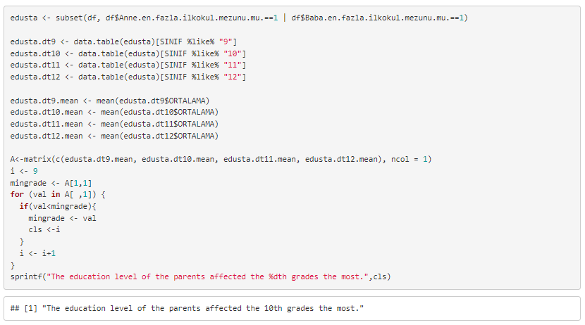
QUESTIONS – 5
5) At which grade level is the educational status of the parents more effective?

